Slide 1
A practical guide to reproducible modeling
Veronica Porubsky
Ph.D. student, University of Washington

Slide 2
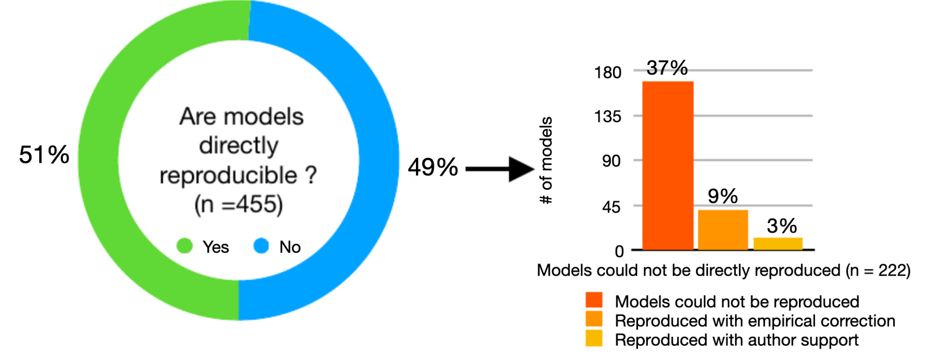
Half of 455 evaluated kinetic models not reproducible
Tiwari et al. (2021) DOI:10.15252/msb.20209982
Notes:
https://physicstoday.scitation.org/do/10.1063/PT.6.1.20180822a/full/

Slide 3

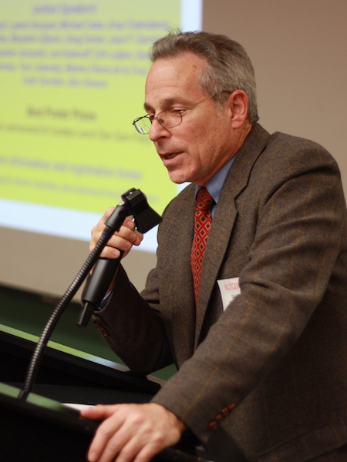
[Tragic] anecdote about reproducibility failing
Dr. Pablo Debenedetti
Dr. David Chandler
Water molecules show a transition from high-density to low-density liquid when supercooled.
Our simulations under similar conditions show that supercooled water just looks like water.
We have validated our approach extensively. Can we see your code to figure this out?
Princeton
UC-Berkeley
“The war over supercooled water” DOI:10.1063/PT.6.1.20180822a
Notes:
https://physicstoday.scitation.org/do/10.1063/PT.6.1.20180822a/full/

Slide 4

7 years later

Slide 5
[Tragic] anecdote about reproducibility failing
Dr. Pablo Debenedetti
Dr. David Chandler
Alright.
Here is our code.
Ah, there is a bug in this Monte Carlo algorithm. It makes your code run faster, but under the wrong physical conditions. Of course water looks like water at this temperature.
Princeton
UC-Berkeley
“The war over supercooled water” DOI:10.1063/PT.6.1.20180822a
Notes:
https://physicstoday.scitation.org/do/10.1063/PT.6.1.20180822a/full/

Slide 6
Agenda
A practical guide to reproducible biomodeling
Cultural shifts to enable reproducible biomodeling

Slide 7
What practical guidelines can we follow to help make our models reproducible?

Slide 8
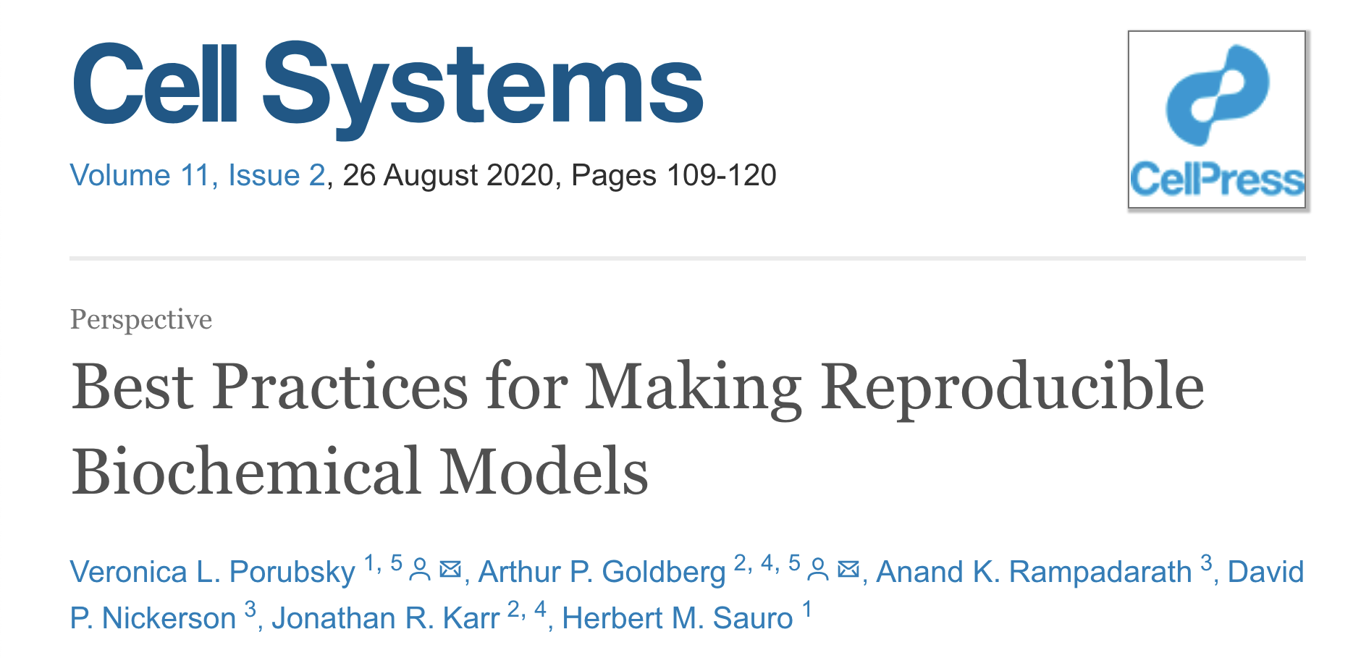
Best practices for reproducible biomodeling

Slide 9

FAIR principles
Recommended tool: GitHub
Image source: https://commons.wikimedia.org/wiki/File:FAIR_data_principles.jpg
Wilkinson et al (2016). DOI: 10.1038/sdata.2016.18

Slide 10
Data aggregation
Best practice: when aggregating and curating data, retain its metadata and provenance
Recommended standard: SEPIO
Recommended tool: bioservices

Slide 11
Model construction
Best practice: make model descriptions comprehensible by using structured formats and unambiguous names
Recommended standards: SBML, SBO
Recommended tool: Tellurium/Antimony

Slide 12
Model construction
Best practice: record the model construction process
Recommended standards: MIRIAM, SBGN
Recommended tools: libomexmeta, sbmlutils

Slide 13
Parameter estimation
Best practice: if parameters are estimated, share the estimation algorithm and perform uncertainty quantification
Recommended standard: PEtab
Recommended tools: SBstoat, PyBioNetFit

Slide 14
Simulation
Best practice: record all simulation inputs and methods, including initial conditions, numerical integration algorithms, random number generator algorithms, and seeds
Recommended standard: SED-ML
Recommended tools: COPASI, Tellurium

Slide 15
Store simulation results
Best practice: save structured unprocessed
simulation results and share the data presented in graphs and tables
Recommended format: HDF5 Recommended tools: numpy, pandas
Notes:
https://www.explainxkcd.com/wiki/index.php/1683:_Digital_Data

Slide 16
Verification & validation
Best practice: automate and document model verification and validation
Recommended tools: sbmllint, pytest

Slide 17
Replication
Best practice: confirm that model predictions can be reproduced in an independent computing environment
Recommended standard: COMBINE archive Recommended tool: BioSimulators

Slide 18
Package artifacts + documentation
Best practice: create packages that contain all model artifacts and documentations, and deposit them in public, version-controlled repositories
Recommended standard: COMBINE archive
Recommended tool: BioSimulators
Recommended database: BioModels, FairdomHub

Slide 19
Big picture “practical” ideas
Use of standards improves ease of reproducibility
Self-contained solutions enable replication
Model versioning supports iterative development
Minimal information criteria or checklists can help you disseminate all relevant information
Software engineering principles support clean and comprehensible code

Slide 20
Can we guide modelers to follow
reproducible practices by influencing the culture?

Slide 21
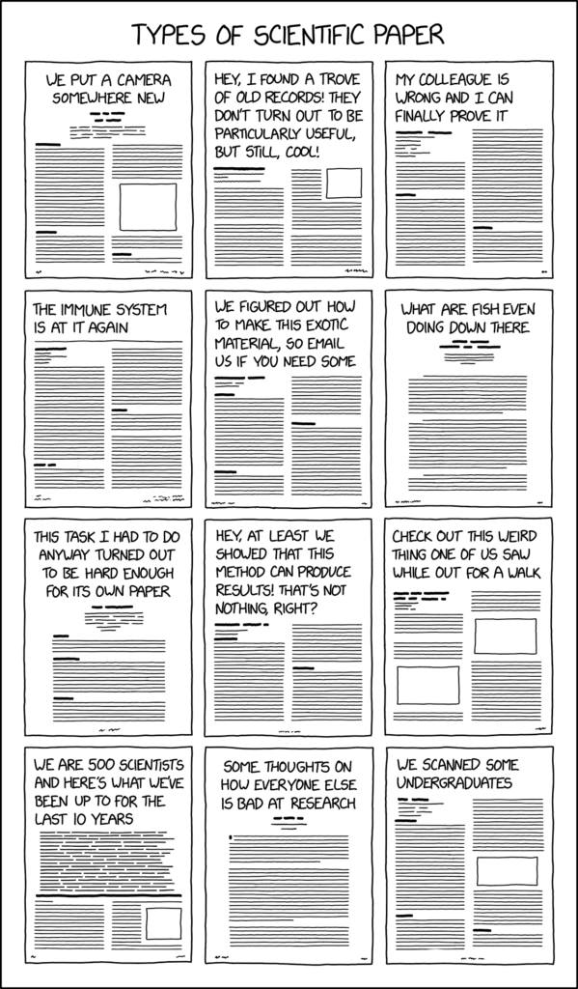




Journals incentive structure
Image source (left): https://xkcd.com/2456/
Image source (right): https://www.acm.org/publications/policies/artifact-review-badging
Notes:
https://theplosblog.plos.org/2019/07/plos-computational-biology-announce-reproducibility-pilot/
https://www.acm.org/publications/policies/artifact-review-badging

Slide 22
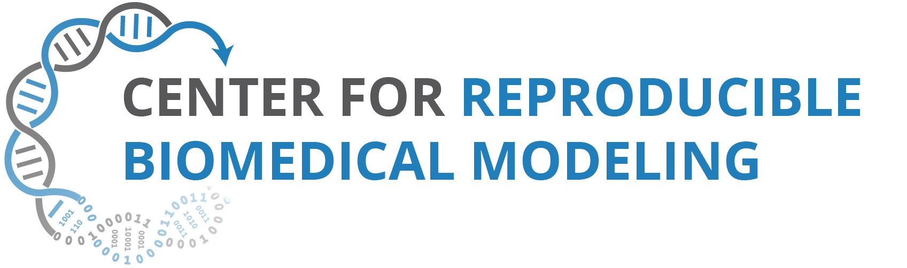
Community support

Slide 23

Community support

Slide 24
Big picture “cultural” ideas
Journals: reward data/code sharing, check if reproducible
Individuals: use open source software, open-access publishing
Communities: could collaboratively develop tools and standards to provide functionality and a common language

Slide 25

Acknowledgements
Best practices paper co-authors: Arthur Goldberg,
David Nickerson, Anand Rampadarath, Jonathan Karr,
Herbert Sauro
The Sauro Lab: especially Lucian Smith, Andy Somogyi,
Steve Andrews, Michael Kochen
Center for Reproducible Biomedical Modeling team:
especially John Gennari
The COMBINE community
Funding:
NIH P41-EB023912

Slide 26
Relevant references
Tiwari et al. (2021). Reproducibility in systems biology modelling. Molecular Systems Biology. DOI: 10.15252/msb.20209982
Ashley G. Smart (2018). The war over supercooled water. Physics Today. DOI: 10.1063/PT.6.1.20180822a
Wilkinson et al. (2016). The FAIR Guiding Principles for scientific data management and stewardship. Sci Data 3, DOI: 10.1038/sdata.2016.18
Porubsky et al. (2020). Best practices for making reproducible biochemical models. Cell Systems. DOI: 10.1016/j.cels.2020.06.012
Association for Computing Machinery (2020) . Artifact Review and Badging Version 1.1 . URL: https://www.acm.org/publications/policies/artifact-review-and-badging-current

